Slide 1
ACCESS-NRI
What it is, Current status and plans
Richard Coleman
Interim Director, ACCESS-NRI project
Emeritus Professor, University of Tasmania, Hobart, Australia
email: Richard.Coleman@utas.edu.au

Slide 2
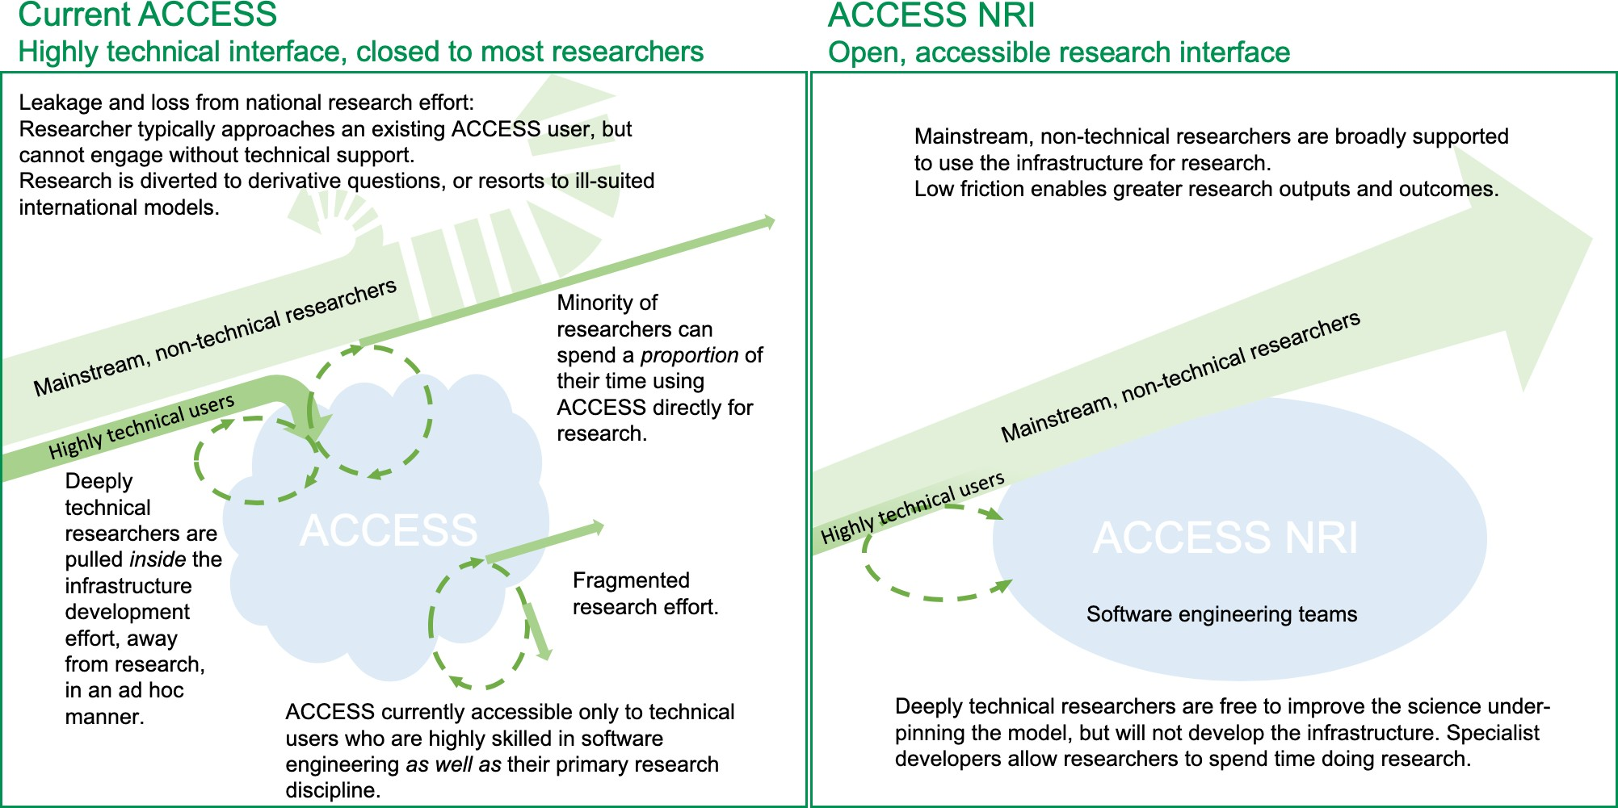
What is ACCESS-NRI
ACCESS National Research Infrastructure (NRI) will provide a software engineering facility for Australia’s Earth Systems research, including weather, climate, decadal, and other areas. Hosted by ANU, the NRI will build collaborative research infrastructure to accelerate research, enable new research not now possible, use computing and data resources more efficiently and future-proof Australia’s investment in key research areas.

Slide 3
ACCESS-NRI aims to:
Avoid the loss of a national weather, climate and Earth systems modelling capability that is inevitable in the absence of a new facility to host a properly software engineering system that meets world standards, and designs and manages the software transition needed for exascale computing and an explosion of big data
Significantly enhance research capability in weather, climate, decadal and Earth Systems modelling necessary for Australia to navigate environmental change
Accelerate research in support of policy makers at the forefront of economy-wide grand challenges, including hazard projections, water security, extreme events, emergency management, etc.

Slide 4
Vision: Australian researchers in weather, climate and Earth Systems Science solve problems of critical national importance now and in the future, using research infrastructure that maximises the value of investment in this and related science necessary to understand and manage the risks and opportunities inherent in environmental change.
Mission: To build a merit-based open access national research infrastructure to transform the quality, scale, significance, efficiency and relevance of Australia’s weather, water, climate and Earth Systems Science research.
Objective: Policy makers, decision makers and resource managers across government, business and community are provided with the scientific research they need for evidence-based action on opportunities and threats posed by ongoing weather and climate variability and trend.

Slide 5
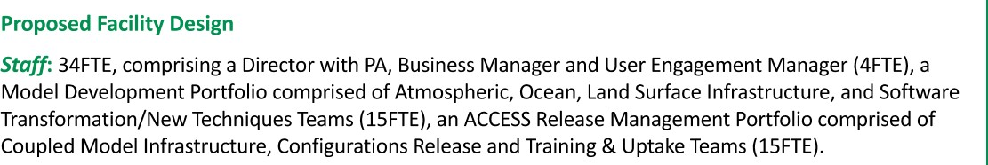
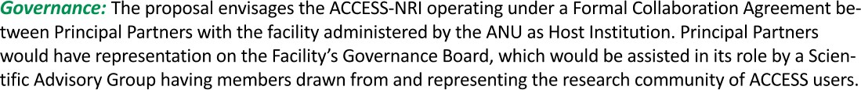
Scoping Study - Chaired by Greg Ayers
after wide consultation and ‘benchmarking’ with research community and technical experts nationally, internationally → proposed design

Slide 6
Current Status
ACCESS-NRI project has $7.6M funding from DESE for 3 years (financial years 2020-21, 21-22, and 22-23). ANU is the Host Agency. Additional cash/in-kind resources for the NRI were outlined by partners in the Scoping document budget. This partner cash/in-kind will be confirmed as part of the next NRI stages.
Next few months (0-3):
Funding Agreement with ANU and DESE to be finalised
Formal Collaboration Agreement to be agreed by ANU and partners*, with agreed budgets and commitments
Governance to be established - NRI Board and Scientific Advisory Group
Merit-Allocation Review process* (*similar to NCI)
Interim Director and NRI Office support staff appointed, including comms/web site

Slide 7
Next steps
Next months (0-6):
Yr 1 Activity Plan required
Some NRI staff to be appointed/seconded -> key Group Leader/Team Leader and software engineers/developers/programmers (up to about 10-12 FTE by Year 1) - PDs written for employment at ANU
One team for science community; one team for code optimisation, documentation, data sets - tbd.
Training and skills development program?
Engage with National Research Infrastructure Roadmap - https://2021nriroadmap.dese.gov.au/
Engage with relevant Govt Departments - DESE, DEWA, …. for end-user benefit : National Climate Resilience and Adaptation Strategy, new Australian Climate Service, NESP2, plus a range of other climate related initiatives across oceans, blue carbon, soils and biodiversity

Slide 8
Future plans
Current NRI period (within 36 months):
Full NRI FTE employed
ACCESS to be model of choice with current models (CM2 and ESM1.5) to be strongly supported
NRI recognised as essential National Infrastructure with ongoing funding, delivering products for science and Govt users
Open questions
Is ACCESS-NRI recognisable beyond the community?
Develop a “MarVL” equivalent for ACCESS?
What have the broad community used ACCESS for - datasets, code? -> construct an inventory and library
How best to communicate?
What other parts of the ESM are needed - cryosphere? Hydrology?

